Slide 1
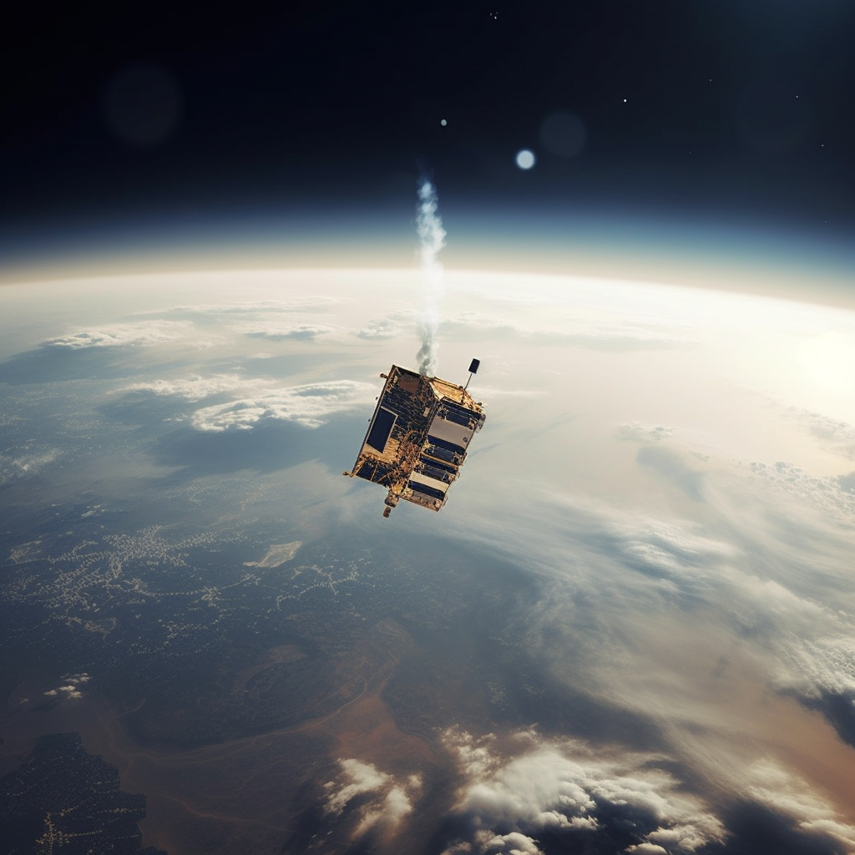
Remote Sensing
Remote sensing is the science of obtaining information about objects or areas from a distance, typically using satellite or aircraft sensors. It involves the use of various technologies and techniques to gather information about the Earth's surface and atmosphere without physically being present at the site.
Remote sensing techniques can be used to collect data on a wide range of features, such as land cover, topography, vegetation, ocean currents, atmospheric composition, and weather patterns. The data can then be analyzed and used to create maps, monitor changes over time, and make predictions about future trends.
Remote sensing is used in many different fields, including agriculture, forestry, urban planning, environmental monitoring, natural resource management, and national security. It is a valuable tool for scientists, policymakers, and decision-makers, allowing them to gather data quickly and efficiently over large areas that may be difficult or dangerous to access by other means.
Discover More, Google: “Sentinel 5P Google Earth Engine” Engine”

Slide 2

Road Infrastructure
Road infrastructure refers to the physical assets and facilities that are used to support road transportation. It includes the construction, maintenance, and operation of roads, highways, bridges, tunnels, and other related structures.
Road infrastructure is essential for facilitating the movement of goods and people, connecting communities, and supporting economic growth. Well-maintained roads improve access to markets, services, and employment opportunities, while also reducing travel time, fuel consumption, and greenhouse gas emissions.
Road infrastructure can be owned and operated by governments, private companies, or public-private partnerships. It typically involves a range of stakeholders, including engineers, planners, construction companies, transportation authorities, and regulatory bodies.
Investment in road infrastructure is critical for meeting the growing demand for transportation and ensuring that roads remain safe, efficient, and sustainable. This involves balancing the need for new construction with the maintenance and repair of existing infrastructure, as well as incorporating new technologies and design approaches to improve safety, reduce congestion, and enhance environmental performance.
Discover More, Google: “Open Street Maps”

Slide 3
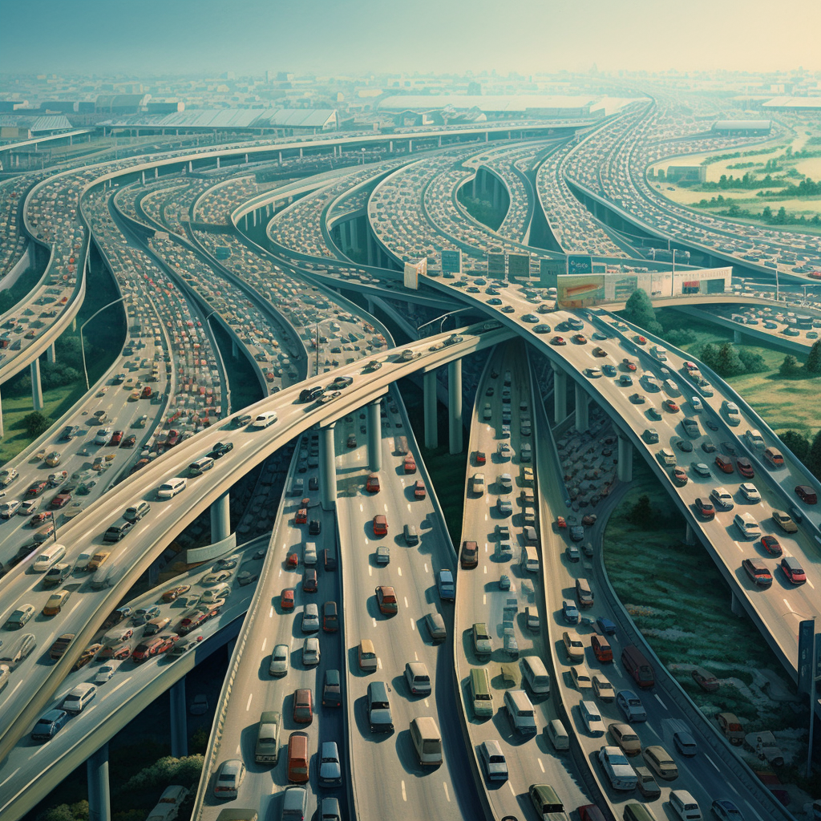
Road Use
Traffic refers to the movement of vehicles, pedestrians, and other objects on a transportation network, such as roads, highways, and bridges. It is an essential component of transportation systems, facilitating the movement of people and goods between different locations.
Traffic can be categorized by its volume, speed, and composition. High-volume traffic occurs in densely populated urban areas or major transportation corridors and can lead to congestion and delays. Traffic speed can also vary depending on the type of roadway and the surrounding environment, such as hills or curves.
The composition of traffic can also have an impact on its characteristics. For example, the presence of large vehicles like trucks and buses can affect traffic flow and safety, and the behavior of pedestrians and bicyclists can impact traffic patterns and road safety.
Effective traffic management is crucial for ensuring the safe and efficient movement of people and goods. This involves a range of strategies, including traffic signal timing, road design and layout, speed limits, and enforcement of traffic laws. It can also involve the use of technology, such as intelligent transportation systems, to monitor and manage traffic flows in real-time.
Discover More, Google: “UK DfT Road Traffic Statistics”

Slide 4
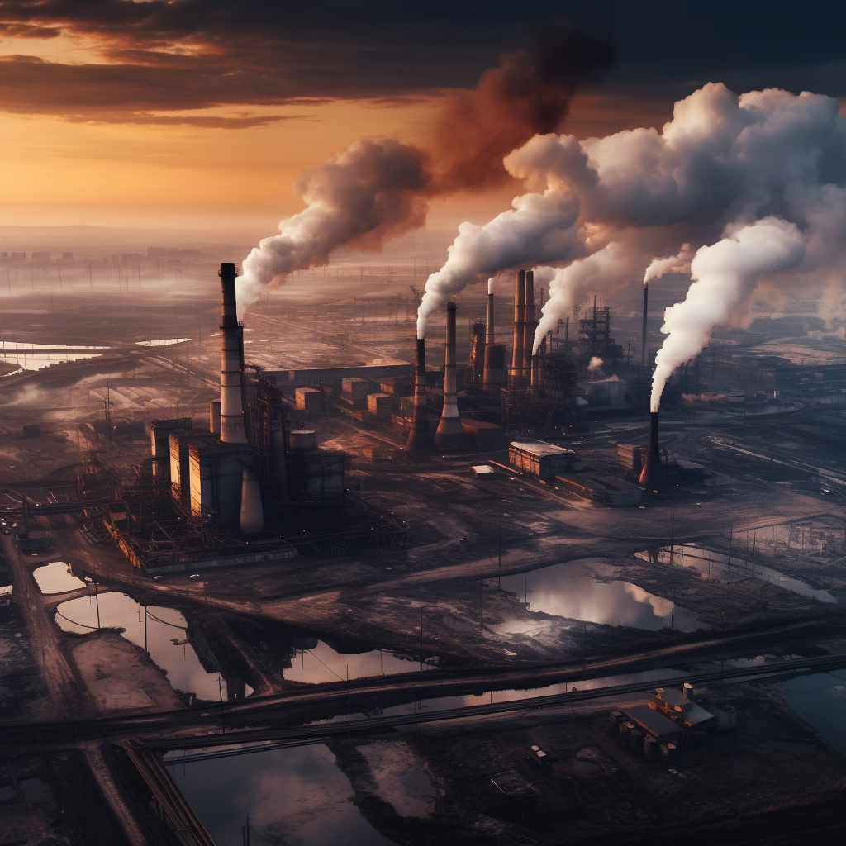
Emissions
Emissions refer to the release of substances into the atmosphere, water, or soil that can have harmful effects on the environment, human health, and/or climate. These substances can be released by natural processes or human activities, such as burning fossil fuels, industrial processes, agriculture, and transportation.
The most common emissions of concern are greenhouse gases, such as carbon dioxide, methane, and nitrous oxide, which contribute to global warming and climate change. Other emissions of concern include air pollutants, such as nitrogen oxides, sulfur dioxide, and particulate matter, which can have harmful effects on human health and the environment.
Emissions can be managed and reduced through a range of strategies, including improving energy efficiency, using cleaner energy sources, implementing emissions controls, and reducing or changing consumption patterns. Governments, businesses, and individuals all have a role to play in reducing emissions and mitigating the impacts of climate change.
Discover More, Google: “UK National Atmospheric Emission Inventory”

Slide 5
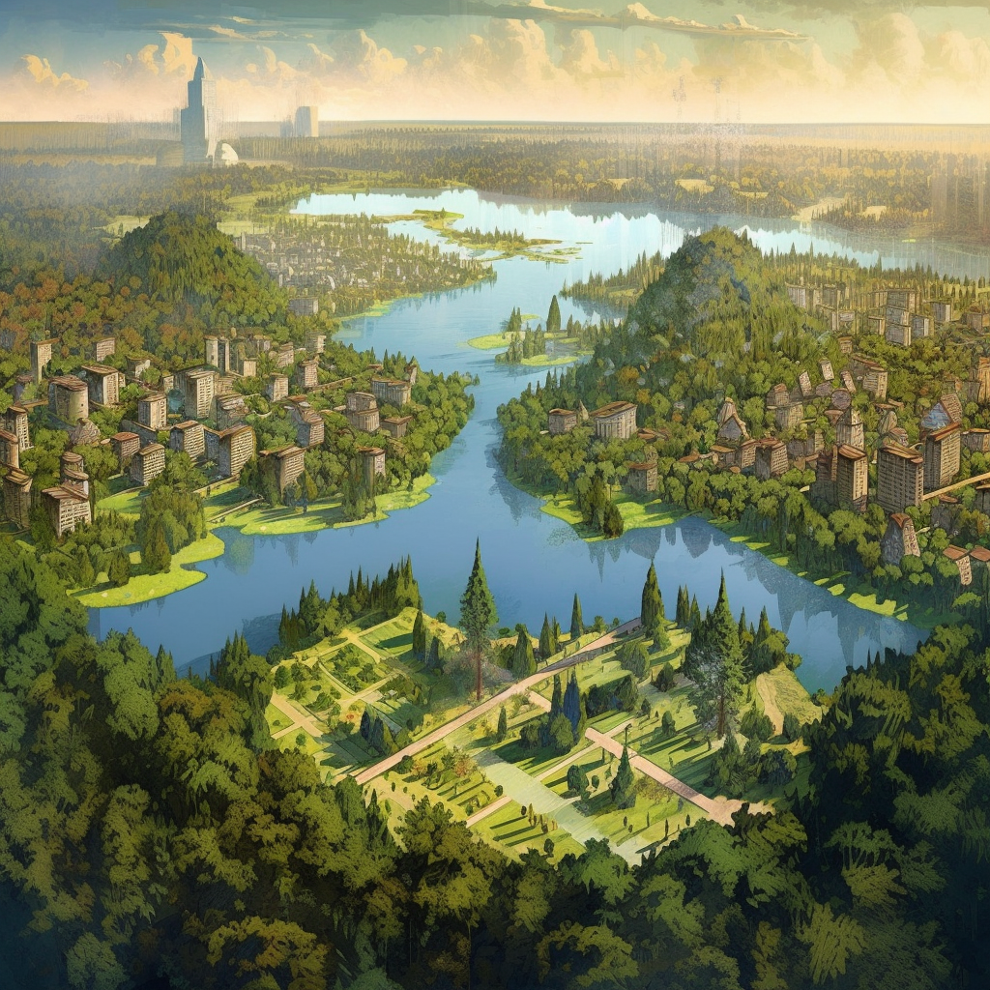
Land Use
Land use refers to the human activities and natural processes that occur on the Earth's surface and the resulting patterns of land cover. It includes the ways in which land is used for agriculture, forestry, urban development, mining, transportation, and other purposes.
Land use is a critical component of sustainable development, as it can have significant impacts on the environment, biodiversity, and human well-being. For example, deforestation can lead to soil erosion, loss of habitat for wildlife, and reduced carbon sequestration, while urbanization can lead to the loss of natural landscapes, increased pollution, and reduced access to green spaces.
Land use planning involves the allocation and management of land resources to achieve specific objectives, such as preserving natural habitats, promoting economic development, and protecting public health and safety. It involves balancing competing interests and priorities, such as environmental conservation, economic growth, and social equity, and requires the involvement of multiple stakeholders, including government agencies, landowners, and community groups.
Effective land use planning involves using a range of tools and approaches, such as zoning regulations, environmental impact assessments, and stakeholder engagement, to ensure that land use decisions are informed, equitable, and sustainable.
Discover More, Google: “UK CEH Land Cover Map”

Slide 6

Meteorology
Meteorology is the scientific study of the Earth's atmosphere, including its physical, chemical, and dynamic properties, and how they affect the weather and climate. Meteorologists use a range of tools and techniques to measure and analyze atmospheric conditions, such as temperature, pressure, humidity, wind speed and direction, and precipitation.
Meteorology plays a critical role in understanding and predicting weather patterns and severe weather events, such as hurricanes, tornadoes, and thunderstorms. It is also important for aviation, agriculture, and many other sectors that are affected by weather conditions.
Meteorologists use a variety of technologies and techniques to collect and analyze data, including satellite imagery, weather radar, weather balloons, and computer models. They use this data to develop weather forecasts, monitor severe weather events, and study climate patterns and trends over time.
Meteorology is a complex and constantly evolving field, with ongoing research into climate change, extreme weather events, and the interactions between the atmosphere and other parts of the Earth system. It is an interdisciplinary field that draws on principles and techniques from physics, chemistry, mathematics, and other sciences to understand and predict atmospheric phenomena.
Discover More, Google: “What is Meteorology? Met Office”

Slide 7
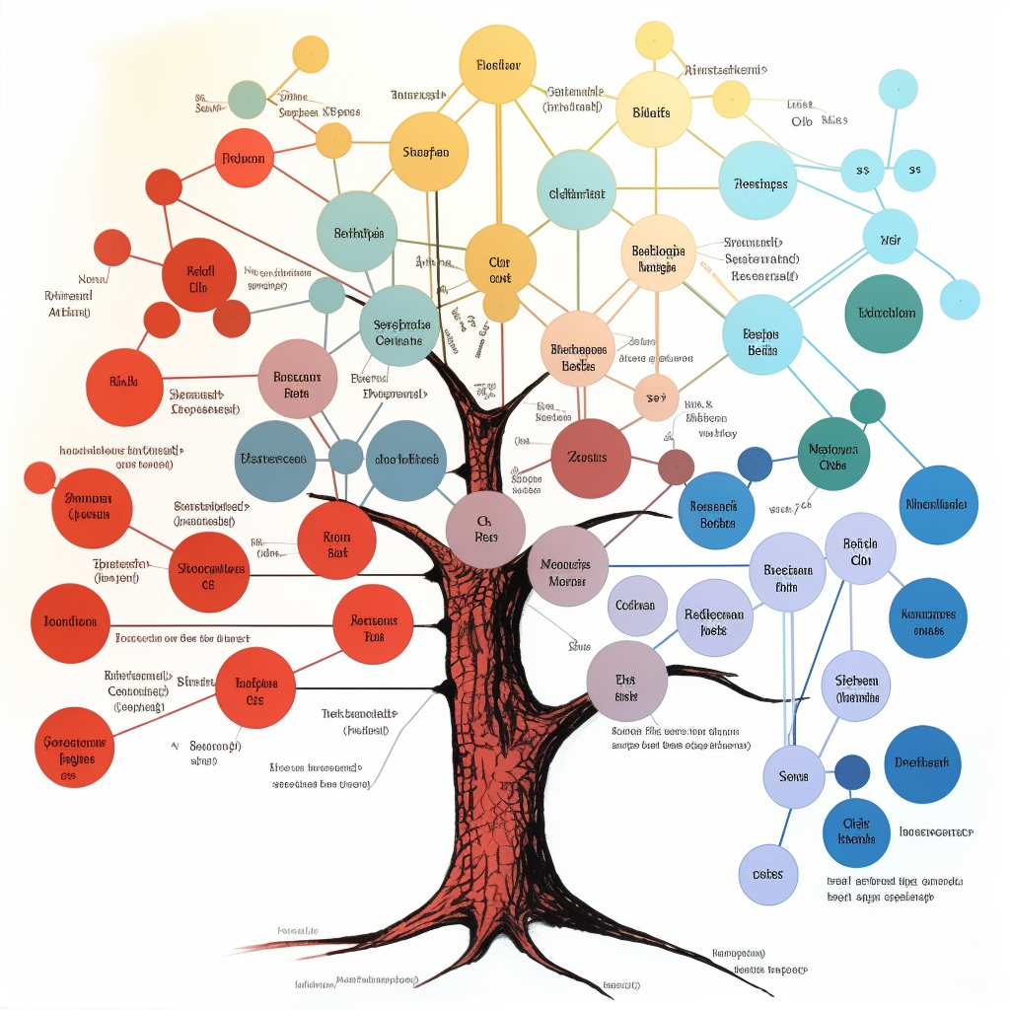
Decision Trees
A decision tree is a decision support tool that uses a tree-like graph or model to map out the possible outcomes of a decision or event. It is a visual representation of a decision-making process, where each branch represents a possible decision or action, and each leaf node represents a potential outcome.
Decision trees are commonly used in fields such as data mining, machine learning, and business analysis to help make complex decisions and identify optimal solutions. They are also used in medical diagnosis, risk analysis, and many other applications where a decision-making process needs to be mapped out.
The structure of a decision tree is based on a series of binary decisions that lead to different outcomes, with each decision node branching out into two or more possible paths. The decision nodes are typically labeled with a question or statement that helps guide the decision-making process, and the leaf nodes are labeled with the corresponding outcome or result.
Decision trees can be constructed manually or through automated algorithms, and can be analyzed using a variety of metrics, such as information gain, entropy, and Gini index, to identify the most important decision points and outcomes. They can also be used in combination with other decision-making tools, such as probability analysis and cost-benefit analysis, to optimize decision-making under uncertainty.

Slide 8
HIGH
VARIABLE
HIGH
VARIABLE
HIGH
VARIABLE
HIGH
VARIABLE
MEDIUM
VARIABLE
MEDIUM
VARIABLE
MEDIUM
VARIABLE
MEDIUM
VARIABLE
LOW
VARIABLE
LOW
VARIABLE
LOW
VARIABLE
LOW
VARIABLE
HIGH
VARIABLE
HIGH
VARIABLE
HIGH
VARIABLE
HIGH
VARIABLE
MEDIUM
VARIABLE
MEDIUM
VARIABLE
MEDIUM
VARIABLE
MEDIUM
VARIABLE
LOW
VARIABLE
LOW
VARIABLE
LOW
VARIABLE
LOW
VARIABLE

Slide 9
High Pollution
Medium Pollution
Low Pollution
Medium Pollution
High Pollution
Medium Pollution
Low Pollution
Low Pollution
High Pollution
Medium Pollution
Low Pollution
High Pollution

Slide 10
ROAD USAGE
REMOTE SENSING
WIND
ROAD INFRASTRUCTURE
URBAN
RURAL
EMISSIONS
TEMPERATURE
SUBURBAN
HOUR
NO₂ REMOTE SENSING
O₃ REMOTE SENSING
DAY OF WEEK

